Slide 1
Project 2 : Ames Housing Data and Kaggle Challenge
Buying a house in Ames, IOWA? This is for you.
Presented by: Rebellon Carina Hipolito

Slide 2
Table of Contents
Introduction
2. Analysis and Findings
3. Recommendation

Slide 3
Introduction
Audience
Context
Problem statement
This study aims to aid the property buyers who are interested in area of Ames, a city in Iowa.
We have gathered some data between 2006 to 2010, it has around 2000 records that contains transaction of sold properties, it includes around 80 features like Year it was built, if it is remodelled, the quality of the property, and neighborhood to name few.
To cater different types of buyers, (1) buyer who wants to maximize their investments, by buying properties that are below average selling price and with acceptable quality, (2) buyers who are willing to pay more with better quality.
What features drives the property price? Is there any neighborhood that have competitive selling price without compromising the quality?

Slide 4
What does data tell us?

Slide 5
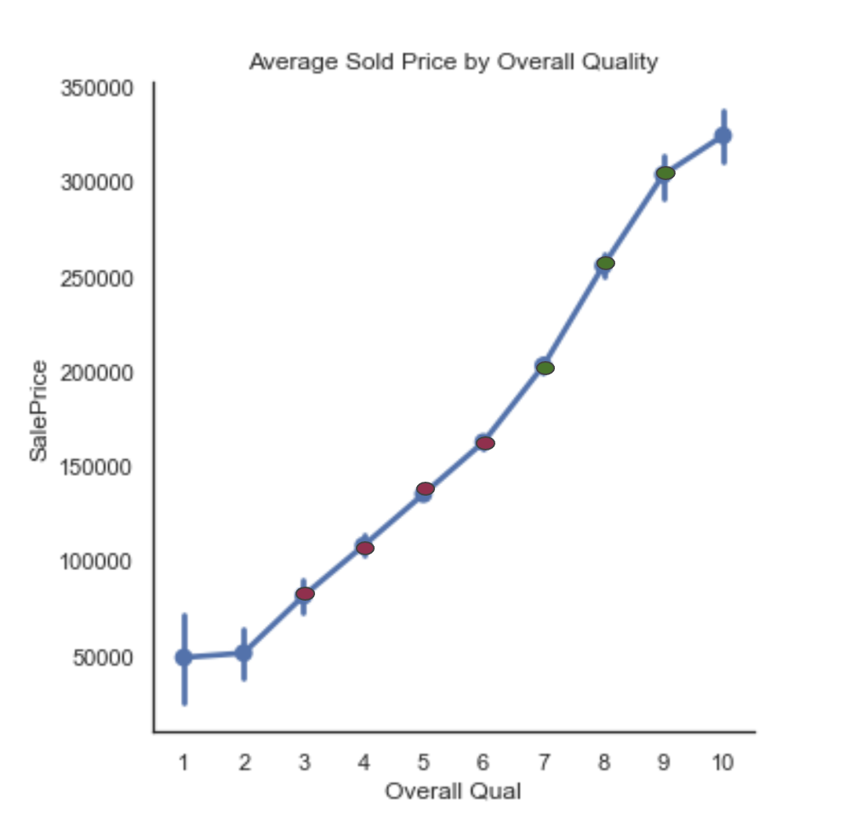
Overall Quality Rating
Top 1 feature that statistically has strong correlation with Selling Price is the Overall Quality of the property, from 1 (Very Poor) .. 5 (Average) to to 10 (Very Excellent)
An unit increase of rating between 3-6 is around 26K to 30K increase in Sale Price.
An unit increase of rating between 7-9 is around 40K to 52K increase in Sale Price
The higher the quality, the steeper the price.

Slide 6
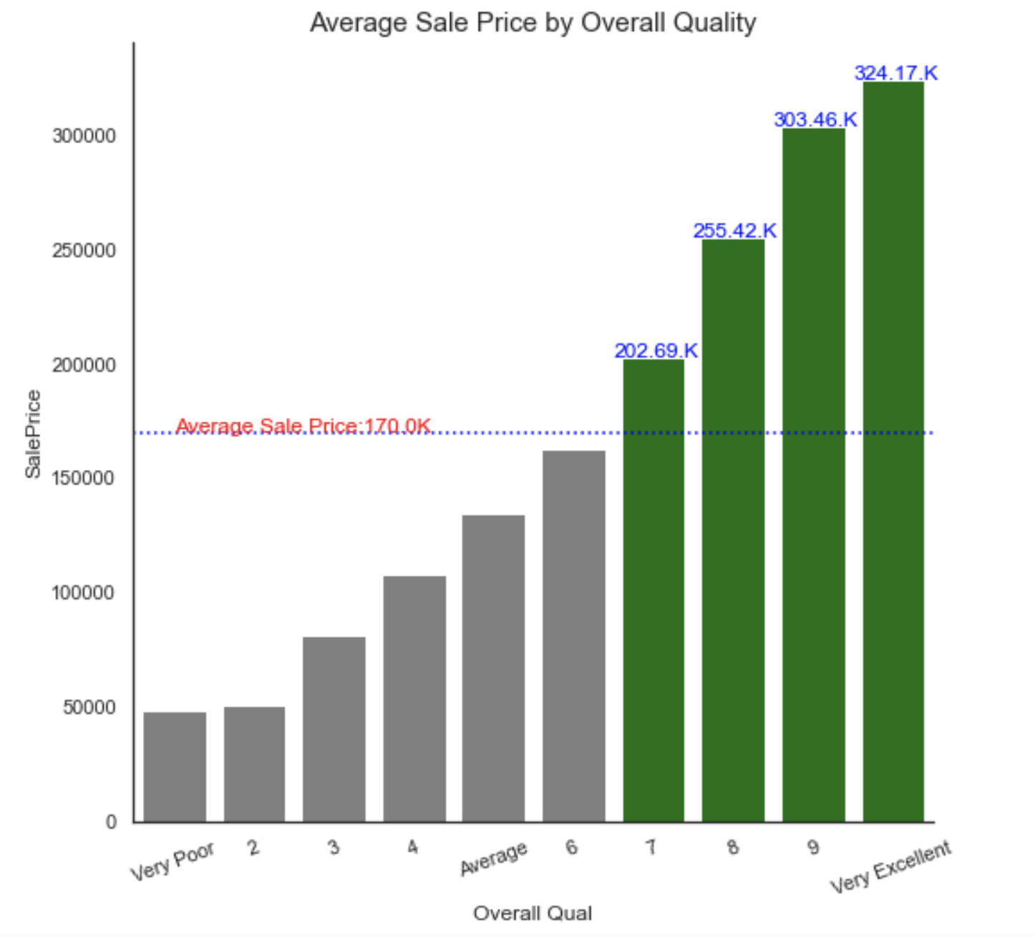
Overall Quality Rating
Very Excellent has more than 90% than the Average Selling Price

Slide 7
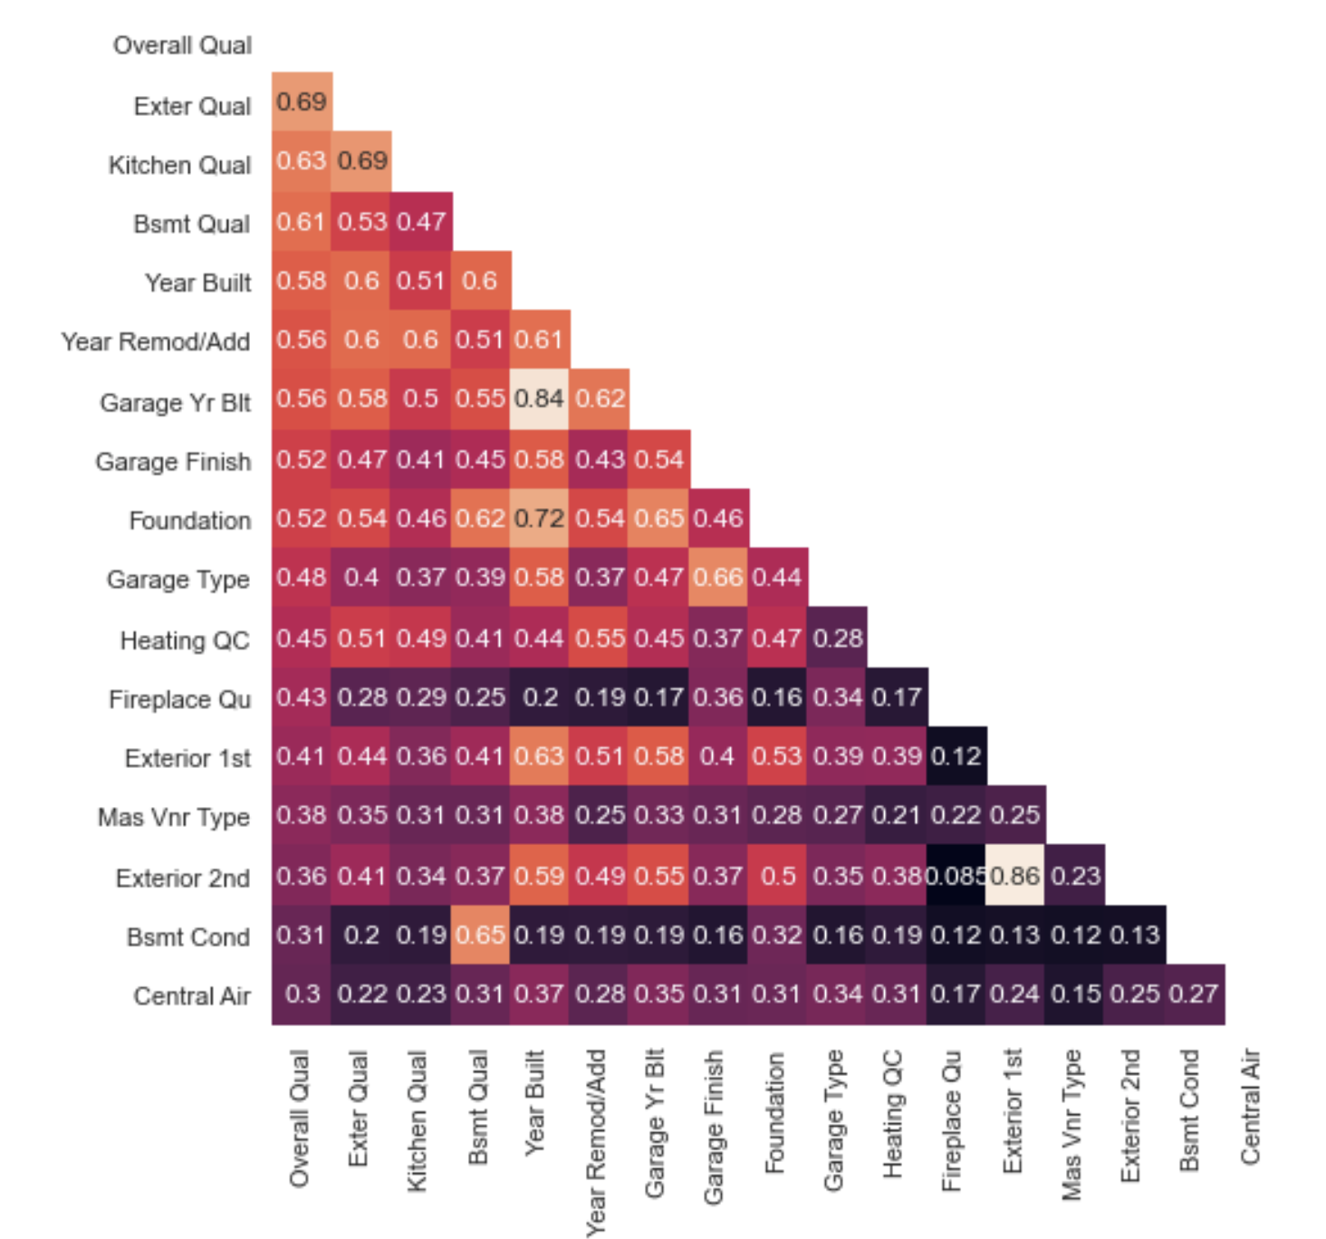
Overall Quality means material and finish quality
Overall Quality rating has correlation with some features like the exterior material quality, kitchen quality, basement quality, the year the property and garage was built or remodeled, foundation of the house, type of garage, heating quality, fireplace quality.

Slide 8
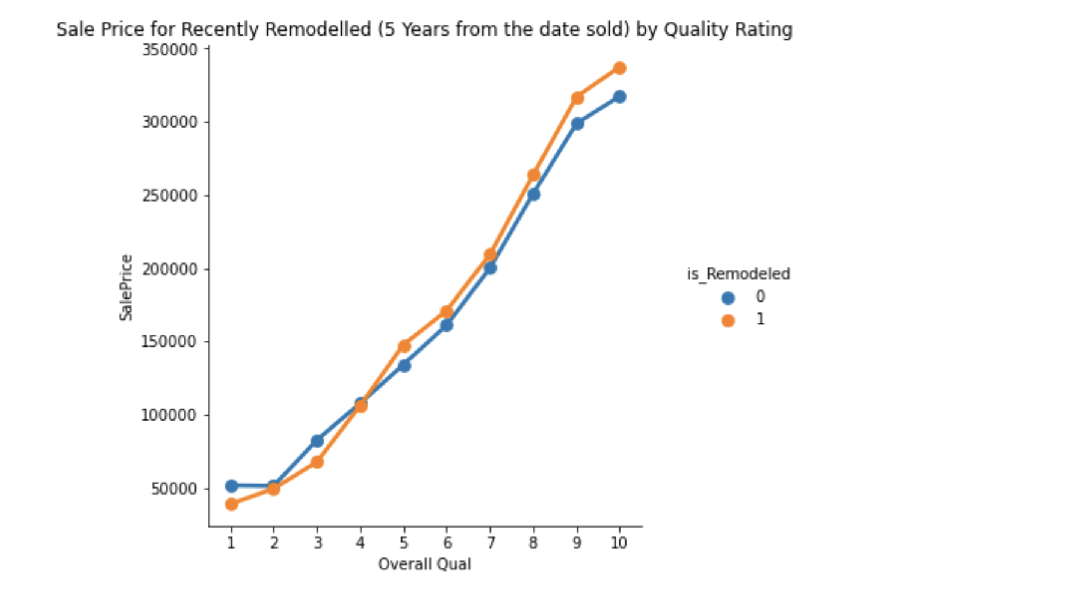
Quality ratings of Remodeled properties
We define Recently Remodeled as properties that are remodelled within 5 years before they are sold.
Remodelling in relation to Sale Price:
There is no significant increase in the Sale Price if the quality is below 5 even if it is remodeled
With the same quality rating, the property that has been recently remodeled still shows a higher price.

Slide 9
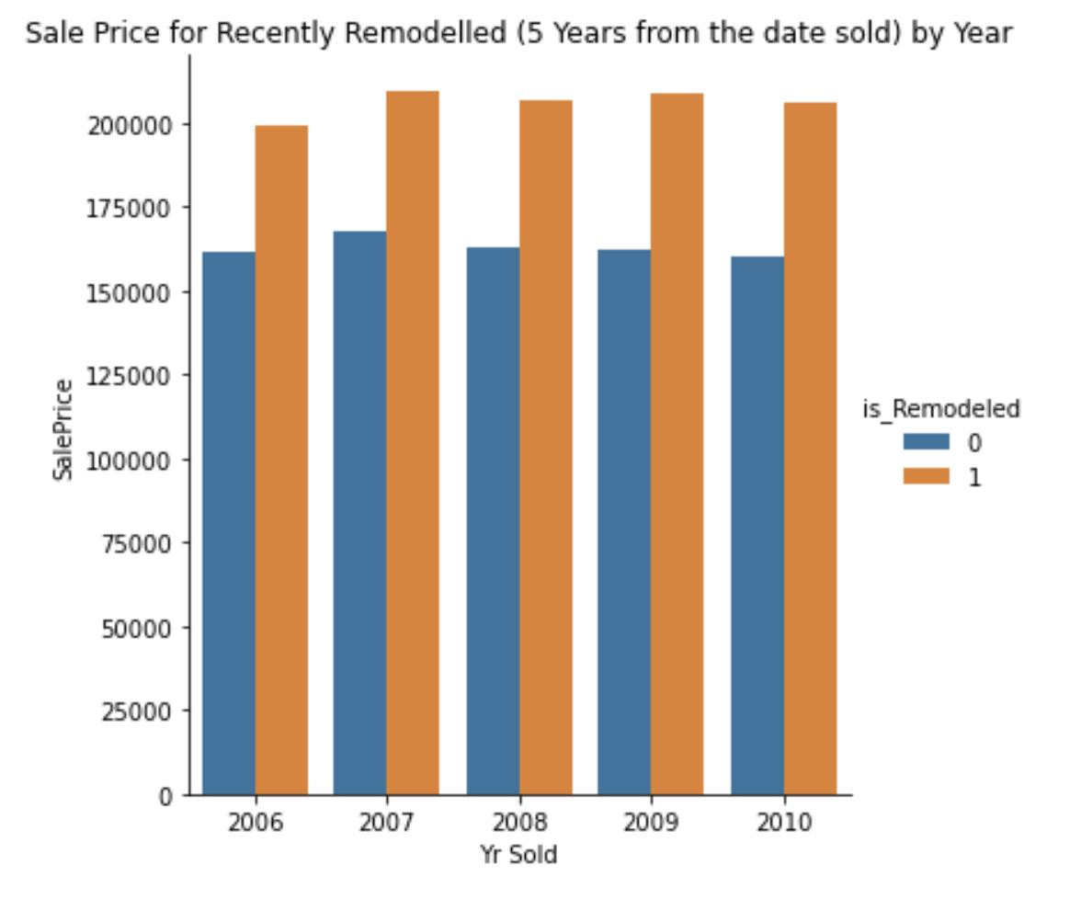
Year on Year Comparison for Remodeled properties
Year over year comparison, the average selling price of recently remodelled properties are higher than those that are not remodeled (or remodeled but older than 5 years)
The increase of Average Selling Price is around 23% to 29%

Slide 10
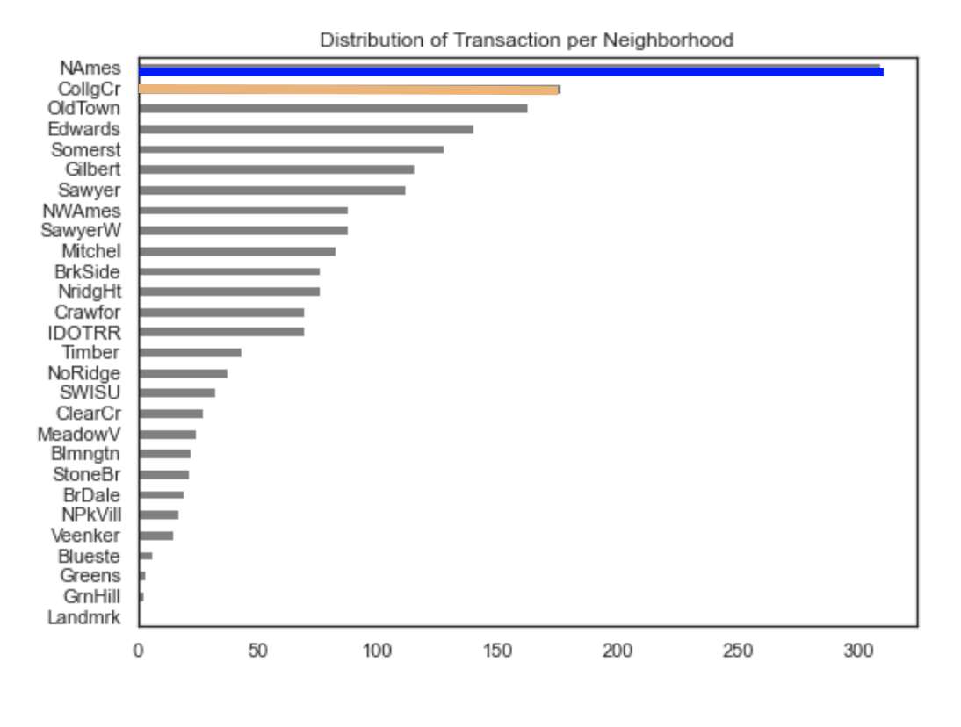
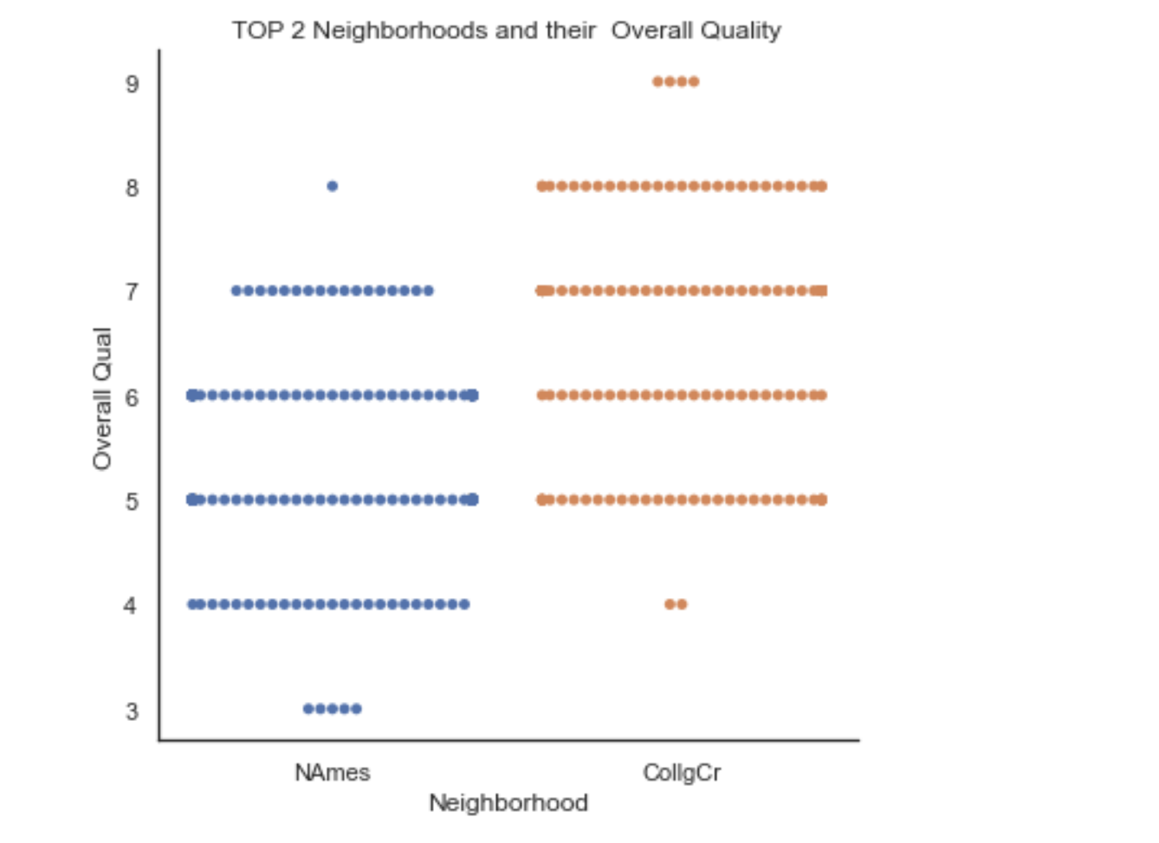
The Neighborhood..
NAmes and CollgCr are top 2 neighborhoods that have most numbers of sold properties over 4 years. CollgCr has better quality rating than NAmes.

Slide 11
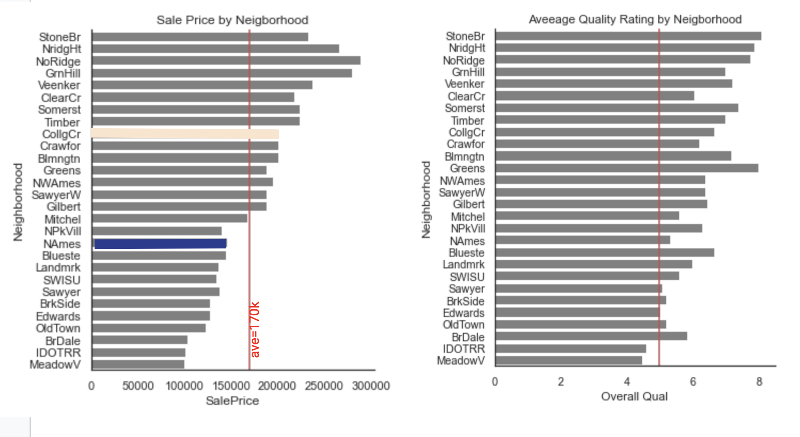
Sale Price and Quality Rating by Neighborhood
NAmes SalePrice is below the average Selling Price, COllgCR is slightly above (since the quality rating is higher too)
For those who are in tight budget but doesn’t want to compromise the quality, we can look at the bottom neighborhood, from NPkVill to BrDale, the selling price is below the average, and the quality rating is above 5.

Slide 12
Summary and Recommendation

Slide 13
NAmes is our top selling neighborhood in terms of quantity, has average selling prices below average, while having good quality rating (rating between 5 to 6)
CollgCR is the second in demand, and the quality is slightly better than NAmes (rating is 6-7), however average the selling price is above 50%.
Summary:
Overall Quality is the feature that has the most significant impact on the Sale Price.
Recommendation:
For those who’s budget are below average, and yet looking for a good quality properties, they can check these 10 neighborhoods, NPkVill, NAmes, Blueste, Landmrk, SWISU, SawyerW, BrDale, BrkSide, Edwards and OldTown, the properties were sold below average and still can choose a better range of quality properties.
You can also save some money by choosing properties that are not remodeled, and yet the quality rating is the same.

Slide 14
Limitation and Considerations:
We don’t have latest data that supports the price are within the same range. Some analysis are general, would the result be the same for all years (e.g. economic crisis in 2008)?
Thank you!

